Slide 1
High vs. Low Egyptian Chronology, the Rising of Sirius in the Lahun and Ebers Papyri, and the exodus
High and Low Egyptian Chronology is based upon three different assumed viewing locations for the annual Heliacal rising of Sirius at Memphis, Thebes, and Elephantine. After showcasing the provenance and contents of both the 12th Dynasty Lahun Papyrus and the 18th Dynasty Ebers Papyrus, pros and cons for each of the three proposed viewing locations will be discussed. Conclusions will be left for the audience to decide.
Steven Rudd, Dallas 2021, JETS/NEAS

Slide 2
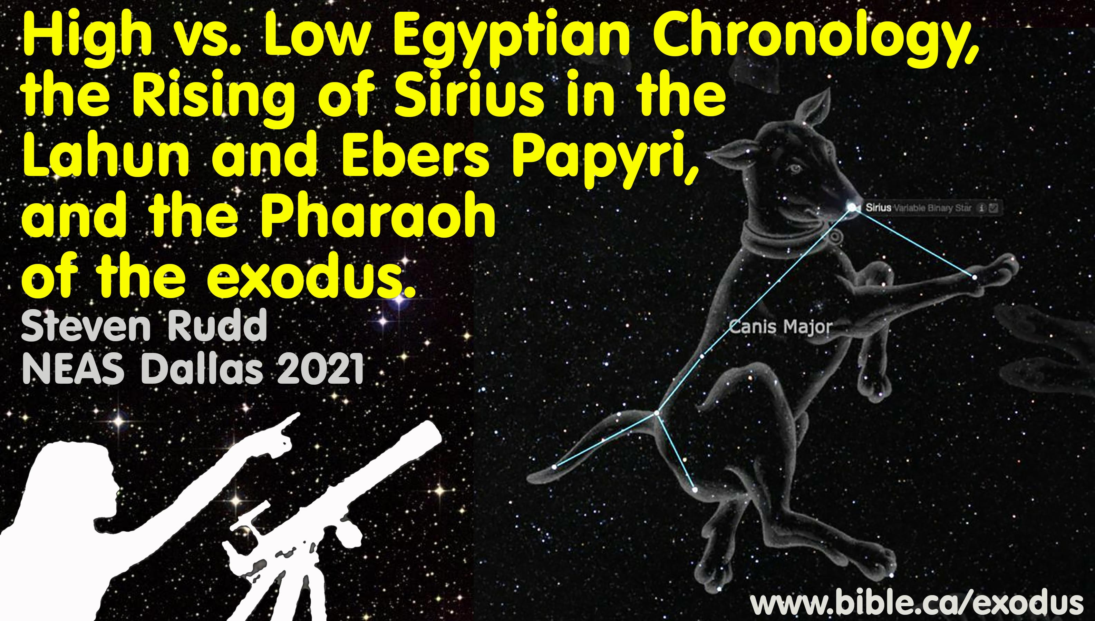

Slide 3
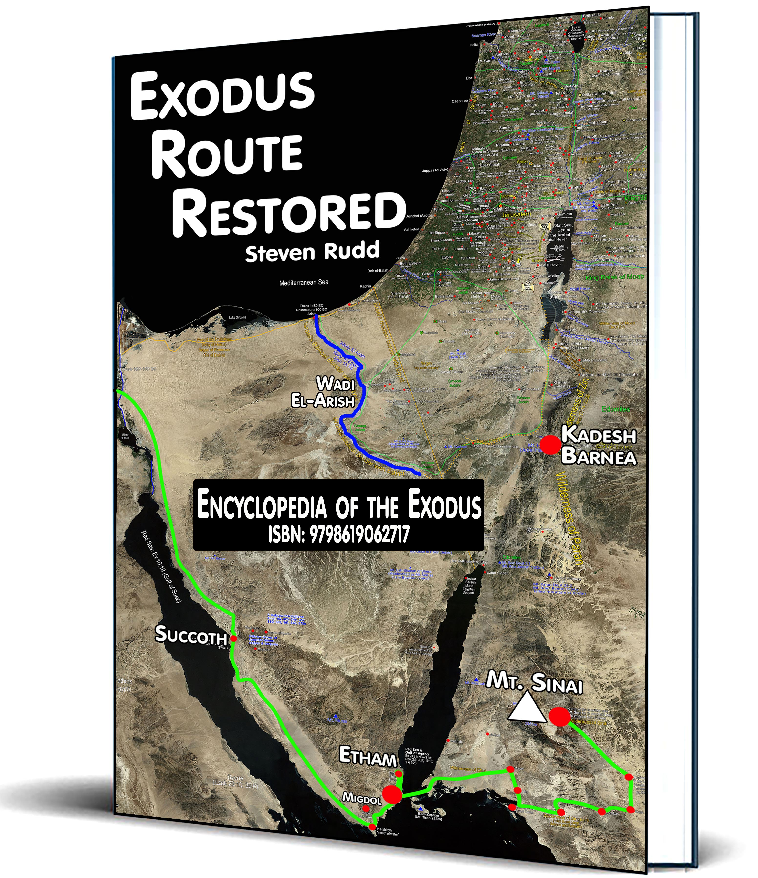
High vs. Low Egyptian Chronology, the Rising of Sirius in the Lahun and Ebers Papyri, and the exodus
Steven Rudd
Dallas 2021
ETS/NEAS
PowerPoint: www.bible.ca/NEAS
Canada@bible.ca www.bible.ca/exodus
4 buying options
Paperback colour: 590 pages: $195 USD
Paperback B&W, 590 pages: $80 USD
Digital 590 pages: $10 USD
Online: Free

Slide 4
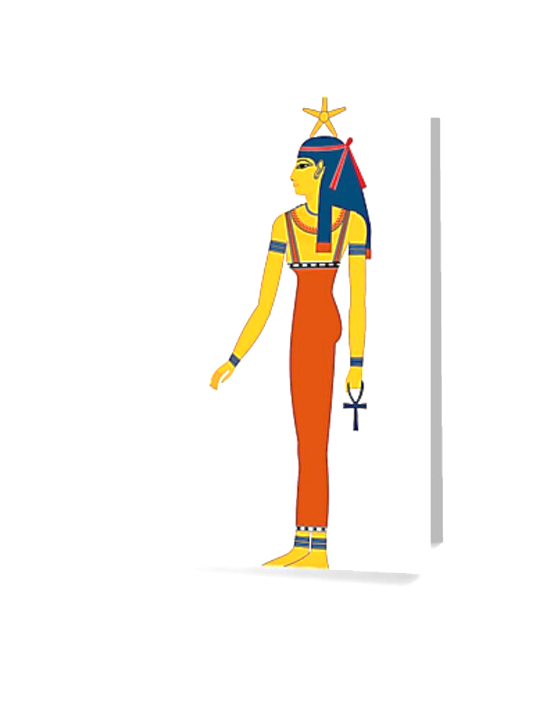
Heliacal rising of Sirius
Sirius is the brightest star in night sky and the brightest star in the Canis Major constellation.
In modern astronomy, Sirius is known as “α Canis Majoris”.
Sirius is known colloquially as the "Dog Star".
To the Egyptians Sirius was the “Dog Star” goddess “Sopdet” who is depicted with a five-pointed star over her head.
To the Greeks Sirius was called Sothis.
Sirius = Sothis = Sopdet = Dog Star.
The “heliacal rising of Sirius” is the first day the “Dog Star” becomes visible just before sunrise, after a period of invisibility at a specific geographic location. Sirius rises on the same day of the solar Calendar at the same observation location. For example, in Cairo, Sirius rises ever year on July 19 in the Julian calendar.

Slide 5
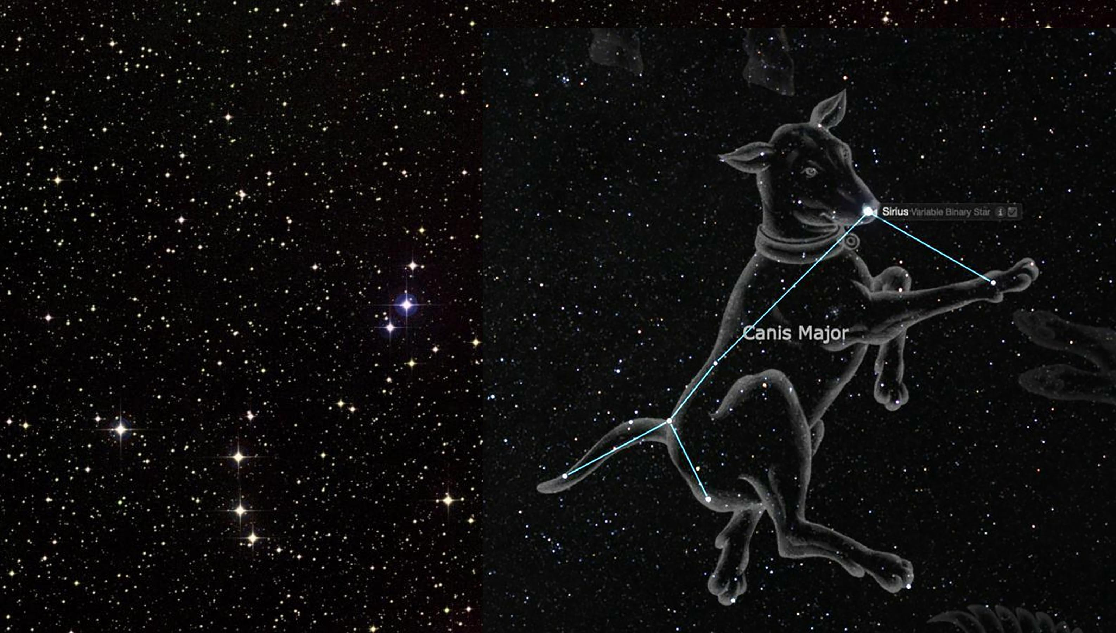
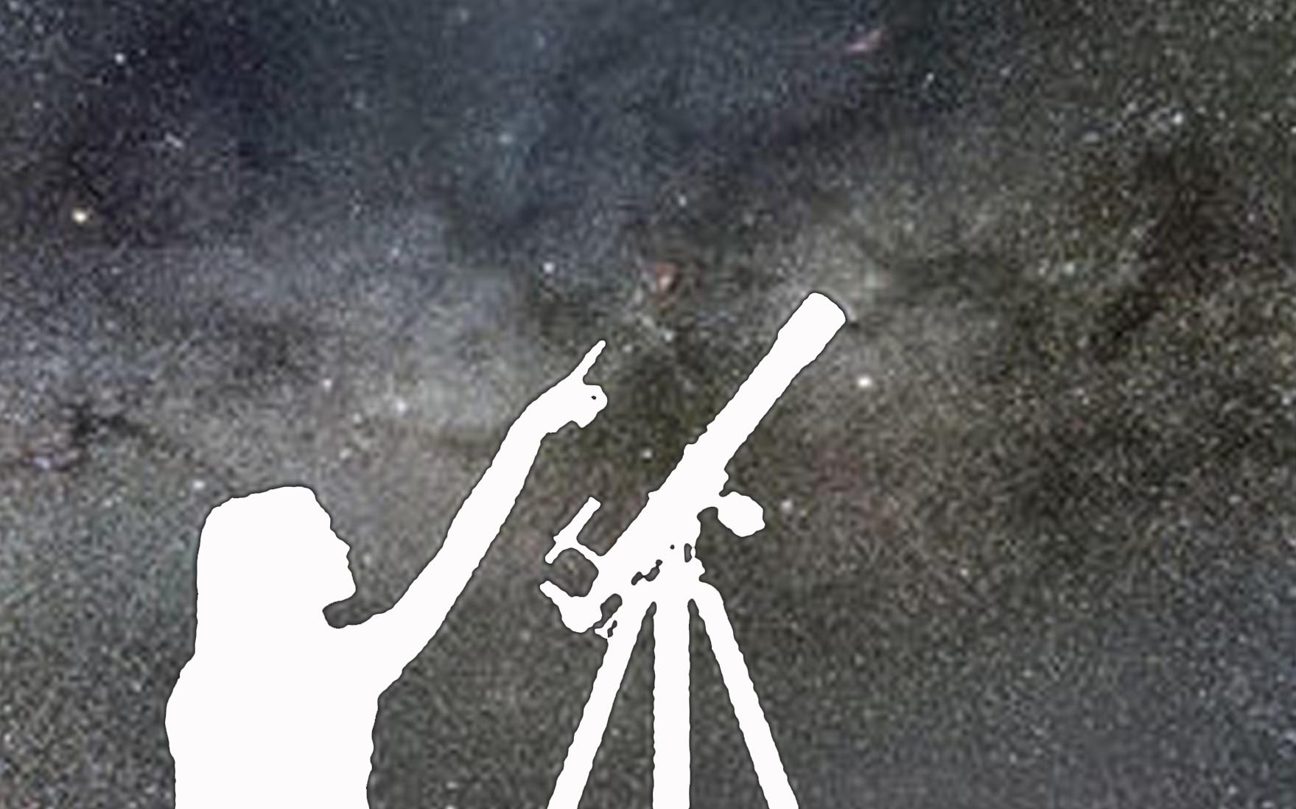
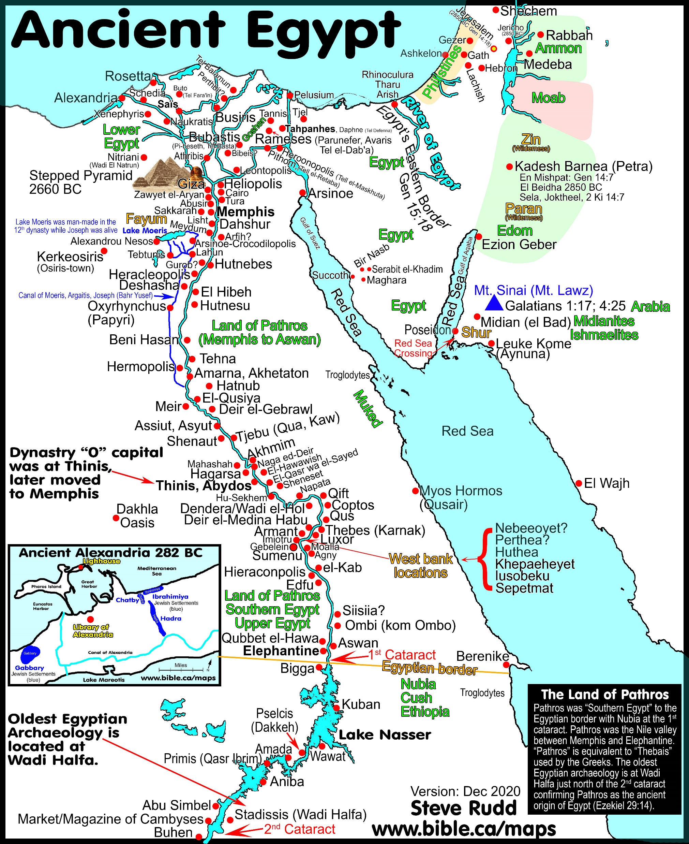
Rising of the Dog Star
Four possible observation points
Memphis
Lahun/Itjtawy
Thebes
Elephantine

Slide 6
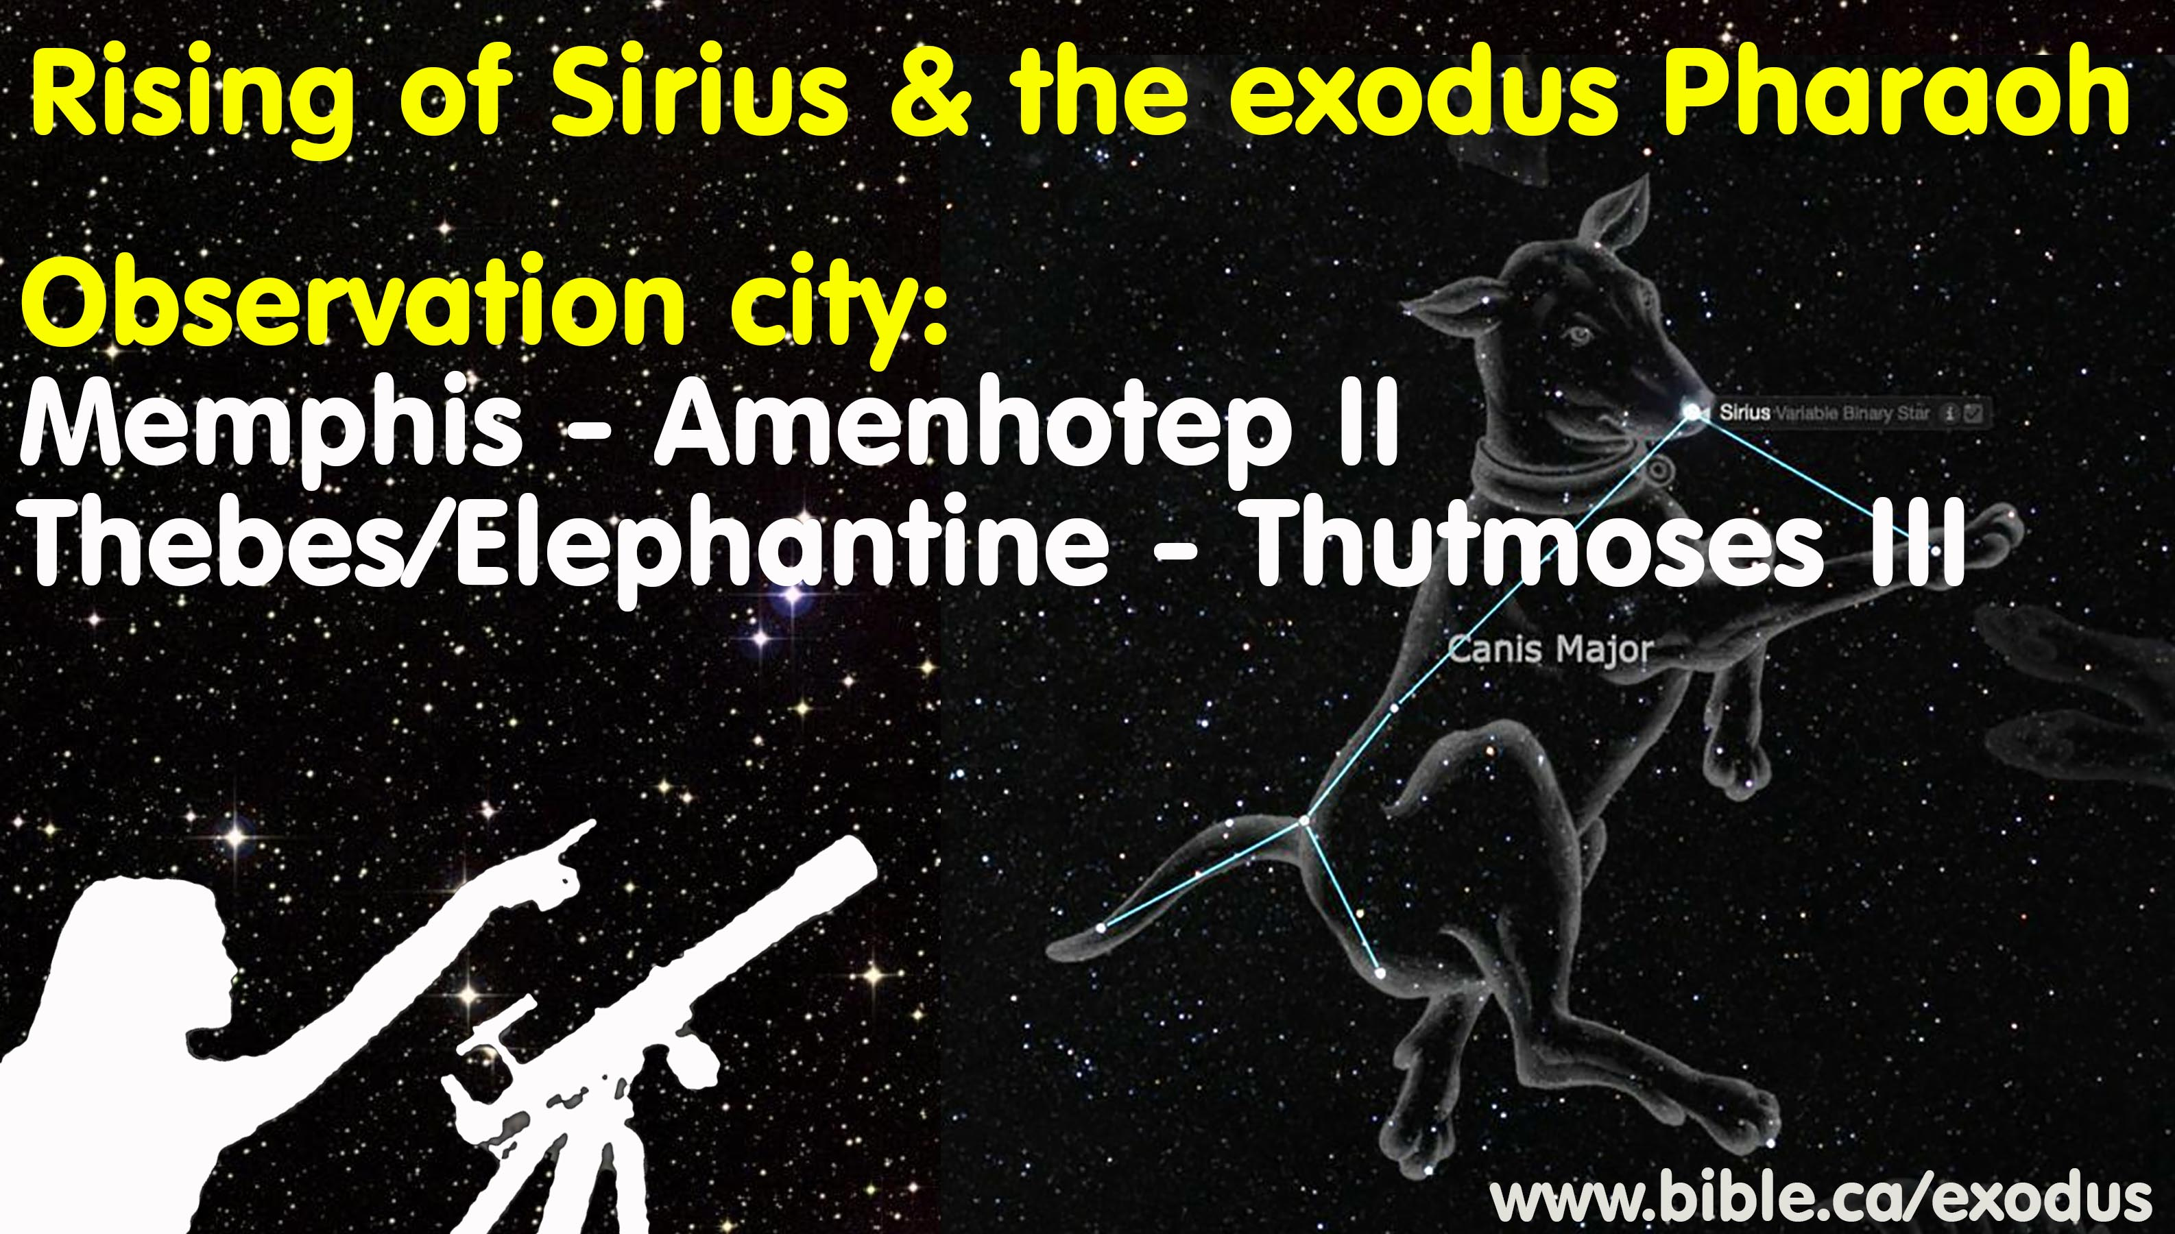

Slide 7
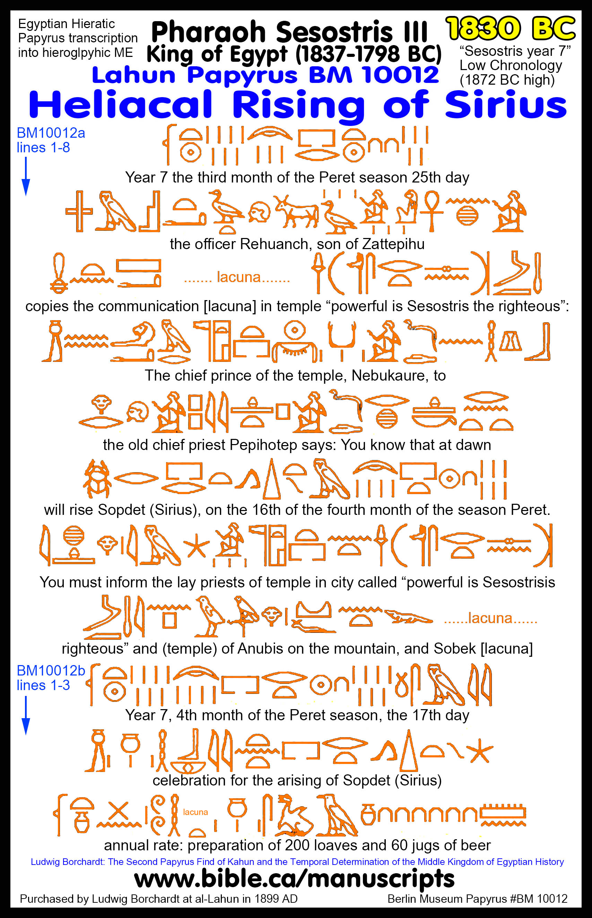
Lahun Papyrus
Translation of El-Lahun Papyrus
BM 10012a: Lines 1-8
“Year 7 the third month of the Peret season 25th day
the officer Rehuanch, son of Zattepihu
copies the communication in the temple “powerful is Sesostris the righteous”:
The chief prince of the temple, Nebukaure, to
the old chief priest Pepihotep says: You know that at dawn
will rise Sopdet (Sirius), on the 16th of the fourth month of the season Peret.
You must inform the lay priests of the temple of the city called “powerful is Sesostris
righteous” and (of the temple) of Anubis that is on the mountain, and of Sobek”
BM 10012b: Lines 1-3
“Year 7, 4th month of the Peret season, the 17th day
celebration for the arising of Sopdet (Sirius)
annual rate: preparation of 200 loaves and 60 jugs of beer”

Slide 8
Provenance of the Lahun Papyrus
BM 10012 was purchased by Ludwig Borchardt at al-Lahun in 1899 AD.

Slide 9
Lahun Papyrus High vs. Low Egyptian Chronology dates
“Year 7 of Sesostris III, powerful, righteous, Month 4 of Peret, Day 17, Celebration of Rising of Sirius”
Sesostris III Kha'kaure'
High Chronology Parker and Cambridge Ancient History 1878-1843 (36) 7th = 1872 @ Memphis Petrovich: 1878-1840 (39) 7th= 1872 @ Memphis | Low Chronology Kitchen 1862-1843 (19) 7th = 1856/55 @ Memphis Krauss 1837-1819 (19) 7th = 1830 @ Elephantine

Slide 10
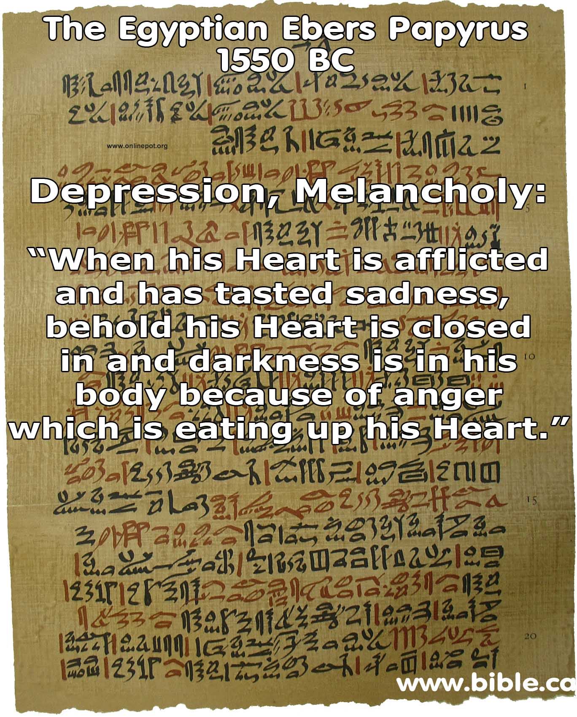
Ebers Medical Papyrus
“When anger arises in his Heart, behold there is a seething-up of the parts of the Intestine and the Liver.”
“When the Heart is sad the vessels of the Heart are closed up , they grow full of air and water, inflammation in the Anus.”
“When his Heart is afflicted and has tasted sadness, behold his Heart is closed in and darkness is in his body because of anger which is eating up his Heart.
“Anxiety and depression is a behaviour choice, not a medical condition.” (Clinical Textbook of Biblical Psychiatry Steven Rudd, 2013 AD)

Slide 11
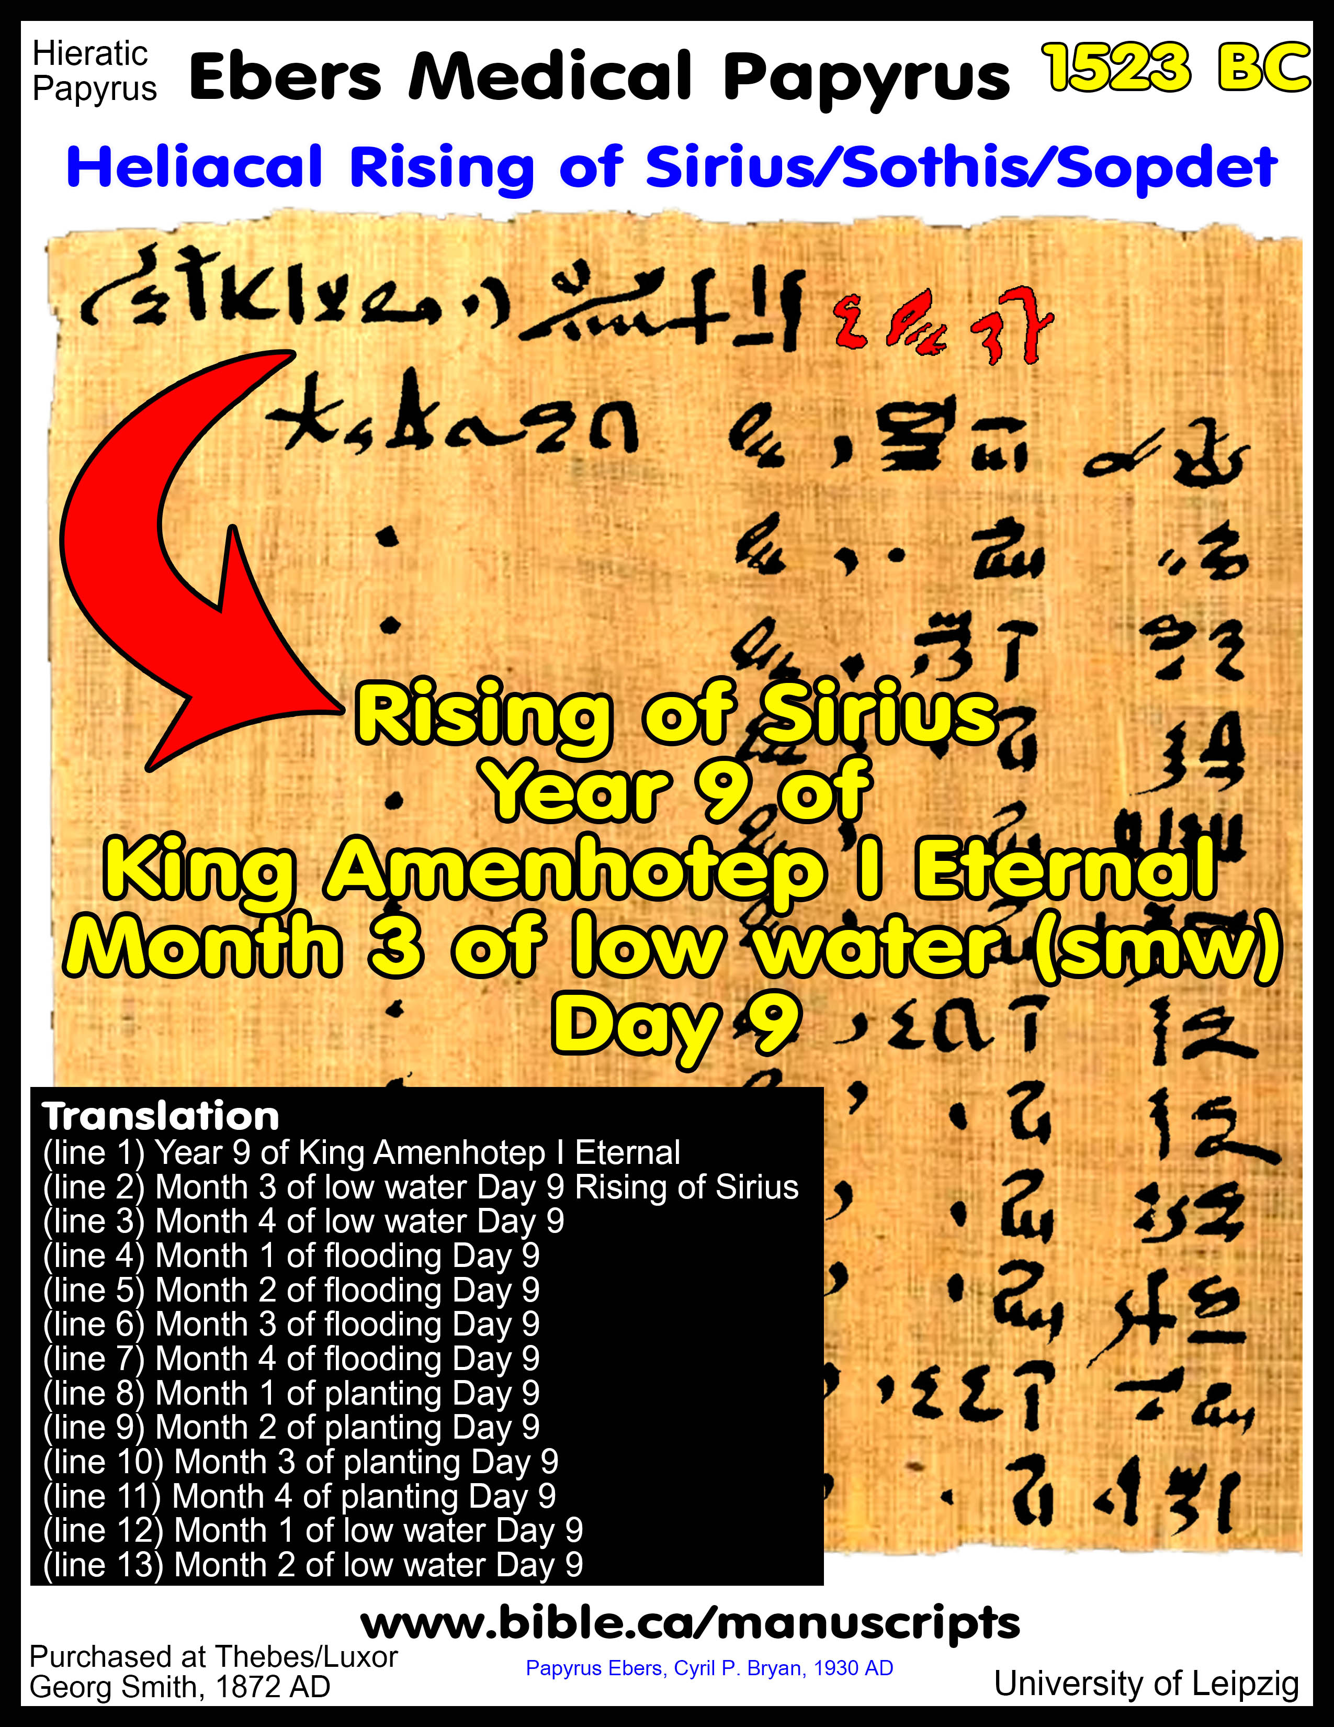
Ebers Medical Papyrus
On the back of the medical papyrus is the Egyptian calendar notation.
Lines 1-13
Year 9 of King Amenhotep I Eternal
Mth. 3 of low water Day 9, Rising of Sirius
Month 4 of low water Day 9
Month 1 of flooding Day 9
Month 2 of flooding Day 9
Month 3 of flooding Day 9
Month 4 of flooding Day 9
Month 1 of planting Day 9
Month 2 of planting Day 9
Month 3 of planting Day 9
Month 4 of planting Day 9
Month 1 of low water Day 9
Month 2 of low water Day 9

Slide 12
Provenance of the Ebers Papyrus
“It was in the winter of 1872 that the German Egyptologist, Georg Ebers, came into possession of the papyrus which according to the usual custom bears his name. Whilst excavating in the vicinity of Thebes he was one day approached by a wealthy Egyptian, who, so he discovered, had made the journey from Luxor expressly to see him. When however the Egyptian produced nothing more exciting than a practically worthless papyrus and a modern statue of Osiris, Ebers suspicions were aroused and he diplomatically informed his visitor that he was prepared to pay handsomely for anything of value that was being held back. The Egyptian thereupon disappeared. The next day he reappeared and handed to Ebers a metal case. Inside, wrapped in old mummy-cloths, was a papyrus the sight of which must have taken the Egyptologist's breath away. The huge roll was in a perfect state of preservation; the writing, both red and black, stood out as clear and vivid as if but written the previous day; and a calendar on the back of the first page indicated a date at the very latest a thousand years before Christ! But Ebers' joy was to be tempered with a little uncertainty. The Egyptian had some idea of the value of his property and fixed the price accordingly. It was beyond Ebers, and for a time the fate of the precious manuscript trembled in the balance. However, the timely appearance of a wealthy compatriot, Herr Gunther, disposed of the financial difficulty; and in a few days Ebers was returning hot-foot to Germany to deposit his treasure in the Library of the University of Leipzig.”
(Papyrus Ebers, Cyril P. Bryan, p1, 1930 AD)

Slide 13
Ebers Papyrus High vs. Low Egyptian Chronology dates
“Year 9 of King Amenhotep I Eternal, Month 3 of low water (smw), Day 9, Rising of Sirius”
Amenhotep I Djeserkare'
High Chronology Cambridge Ancient History: 1546-1526 (21) 9th = 1537 @ Memphis Petrovich: 1550-1529 (21) 9th = 1541 @ Memphis | Low Chronology Kitchen: 1525-1504 (21) 9th = 1516 @ Thebes Krauss: 1514-1494 (21) 9th = 1506 @ Elephantine

Slide 14
Summary
High and Low Egyptian Chronology, the Rising of Sirius Observation Locations and Corresponding Dates
Manuscript | Purchased | Dynasty | Egyptian date | Ithet-Tawy/Memphis | Thebes | Elephantine
Lahun Papyrus BM 10012 | El-Lahun | 12th Dynasty. Capital at Ithet-Tawy | 7th year of Sesostris III | 1872 BC (Petrovich/Parker) 1856 BC (Kitchen) | - | 1830 BC (Krauss)
Ebers Papyrus | Thebes/Luxor | 18th Dynasty. Capitals at Thebes and Avaris | 9th year of Amenhotep I | 1541 BC (Petrovich) | 1516 BC (Kitchen) | 1506 BC (Krauss)

Slide 15
Variables in determining the observation location
1. Ancient literary sources
Ancient literary sources
Olympiodorus of Alexandria: AD 565
The Sothic rising was observed from Memphis, celebrated at Alexandria.
Problems:
Pharaonic Egypt went extinct in 525 BC fulfilling Daniel 2:39; 8:20 (Cambyses)
“Celebrated at Alexandria” which didn’t exist until after 333 BC (Alexander)
“As Krauss insists, one can hardly use this as the basis for establishing where such observations were made in pharaonic times.”
(Present Status of Egyptian Chronology, William A. Ward, BASOR 288, p59, 1992 AD)

Slide 16
Variables in determining the observation location
2. Purchase location of Ebers and Lahun Papyri
Ancient literary sources
Problems with provenance
Ebers purchased in Thebes vs. Lahun purchased in Lahun
Lahun is 75 km south of Memphis and 425 km north of Thebes
  Thebes is 500 km south of Memphis
  Nobody argues that Lahun was where Sesostris III observed the rising of Sirius, even though it was not only where the Lahun Papyrus was purchased, but it was also the location of the pyramid of Sesostris III.
  Nobody argues that a Dead Sea Scroll purchased by an antiquities trader in New York City was provenanced in NYC.

Slide 17
Variables in determining the observation location
3. Fixed or moveable viewing location: Kitchen/Ward
Ancient literary sources
Kenneth Kitchen and William Ward: Moveable observation city
“It seems far more likely that the twelfth Dynasty [Lahun Papyrus] observations were made near Memphis, … while the eighteenth Dynasty [Ebers Papyrus] observation occurs in a papyrus found at Thebes.”
(Chronology of Ancient Egypt, Kenneth A. Kitchen, World Archaeology, Vol. 23, No. 2, pp. 205, 1991 AD)
“William Ward, on the other hand, suggested that they are all more likely to have been separate local observations … may actually have taken place at different times and in different parts of the country” (Oxford History of Ancient Egypt, Ian Shaw, p9, 2000 AD)

Slide 18
Variables in determining the observation location
4. Capital city of the day: Kitchen
Ancient literary sources
Kenneth Kitchen: Sirius observed from current capital city
“observation occurs in the [Ebers] papyrus found at Thebes , actually the capital under Amenophis I. … [this] makes best sense- but is not cast-iron.” (Chronology of Ancient Egypt, Kenneth A. Kitchen, World Archaeology, Vol. 23, No. 2, pp. 205, 1991 AD)
Problems
It would be expected that documents like the Ebers or Lahun Papyri would be stored in the capital city even if the rising of Sirius was observed at distant Elephantine.
The capital city in 12th Dynasty was Itjtawy, perhaps located 35 km south of Memphis at Lisht, which lowers the chronology for P. Lahun

Slide 19
Variables in determining the observation location
5. Memphis as the observation city
Ancient literary sources
Kitchen favoured Memphis as the 12th Dynasty observation location in the Lahun Papyrus in the 19th century BC
Sesostris III, who recorded the rising of Sirius in the Lahun Papyrus, build his first pyramid at Dashur, 4 km south of Memphis.
Problems
Neither the Ebers nor Lahun Papyrus were purchased in Memphis.
Memphis may not have been the capital city in the 12th and 13th Dynasty
No 12th Dynasty pyramids were built in Memphis

Slide 20
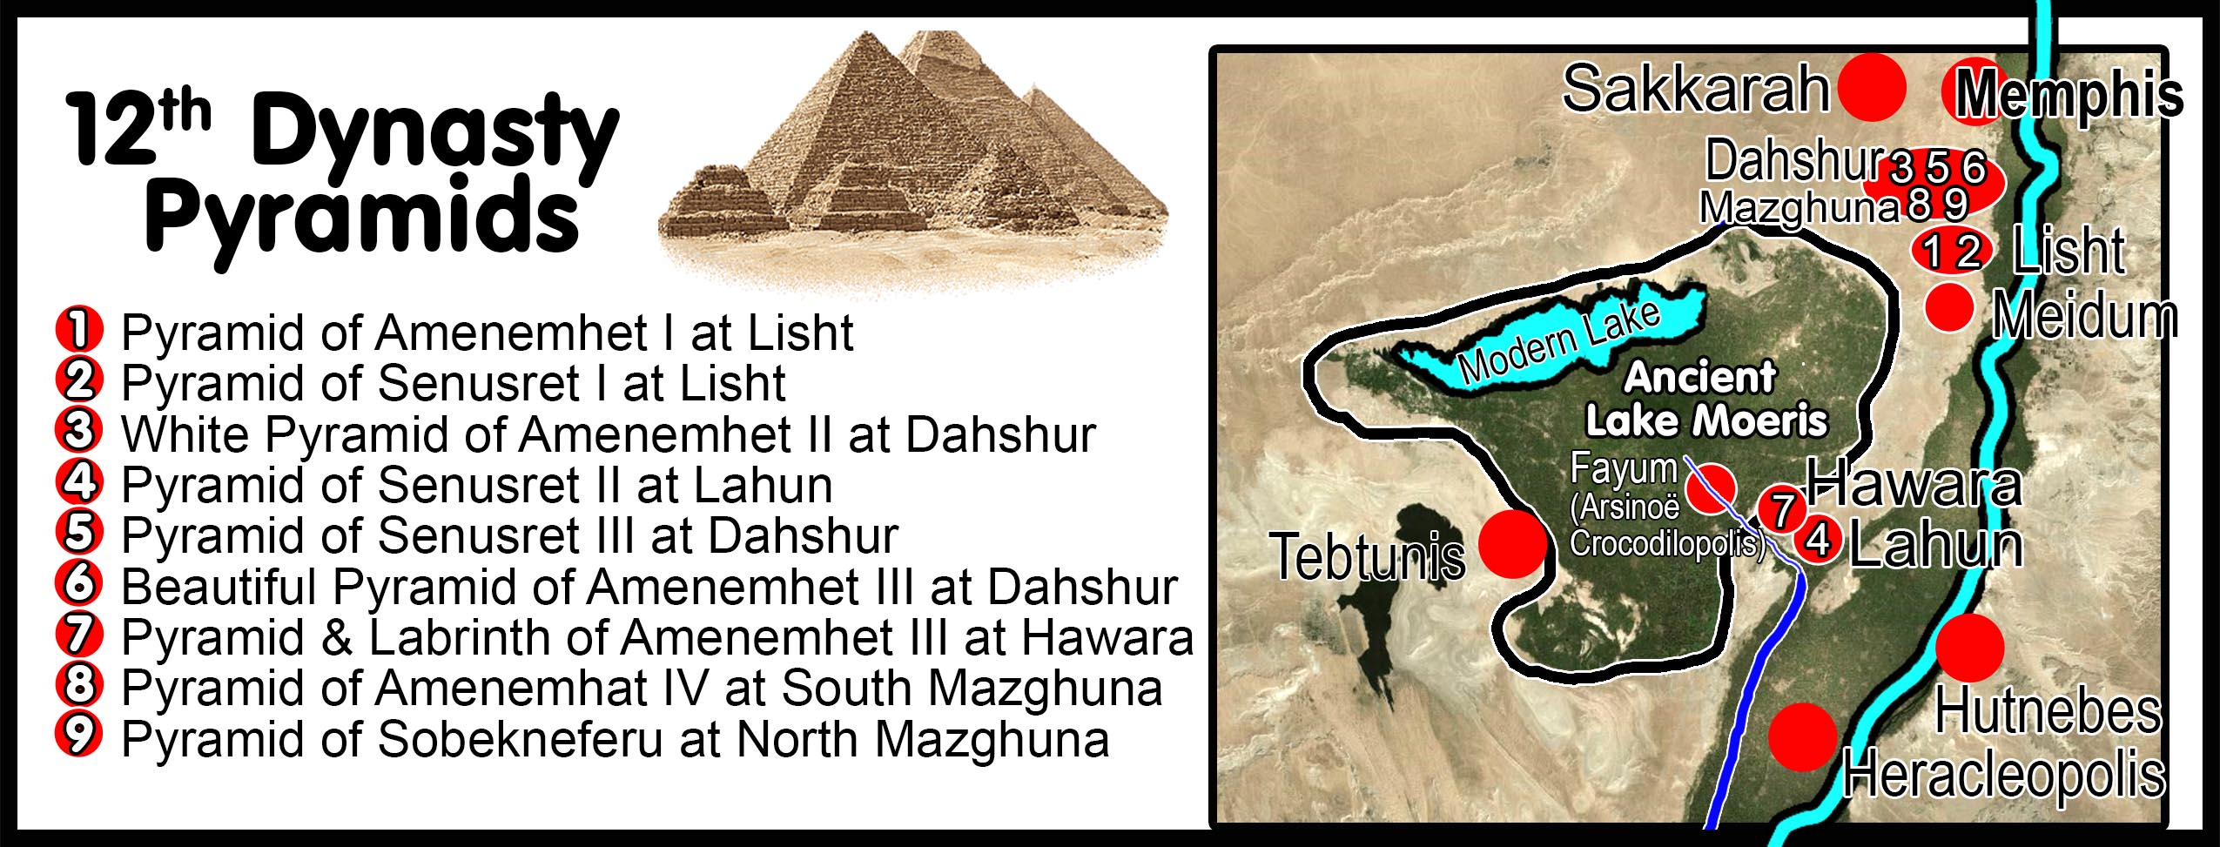
No Twelfth Dynasty pyramids were built in Memphis

Slide 21
Variables in determining the observation location
6. Itjtawy (Ithet-Tawy) as the observation city
Ancient literary sources
Capital city of the 12th and 13th Dynasty
Kitchen: “twelfth Dynasty [Lahun Papyrus] observations were made near Memphis, in the then capital-suburb of Ithet-Tawy [Itjtawy]
(Chronology of Ancient Egypt, Kenneth A. Kitchen, World Archaeology, Vol. 23, No. 2, pp. 205, 1991 AD)
Gae Callender: “One of Amenemhat's [I] most significant moves was to transfer Egypt's capital from Thebes to the new town of Amenemhat-itj-tawy ('Amenemhat the seizer of the two lands'), sometimes known simply as Itjtawy, a still-undiscovered site in the Faiyum region, probably near the Lisht necropolis.
(Middle Kingdom Renaissance, Gae Callender, Oxford History of Ancient Egypt, editor Ian Shaw, p146, 159, 2000 AD)
Problems
Uncertain location, possibly 35 km from Memphis.

Slide 22
Variables in determining the observation location
7. Lahun as the observation city
Ancient literary sources
Lahun was a major construction and activity centre in the 12th Dynasty
The Lahun Papyrus was purchased at el-Lahun.
Lahun was the location of the Pyramid of Sesostris II.
Amenemhat III built his second pyramid and Labyrinth at Hawara, located 8 km west of Lahun.
Lahun is the end of the “Canal of Joseph” and entrance to the “Lake of Joseph”.
In the 12th Dynasty Lahun could be argued as a logical observation point for the rising of Sirius, superior to Memphis.

Slide 23
Variables in determining the observation location
8. Thebes as the observation city
Ancient literary sources
Kitchen favored Thebes as the 18th Dynasty observation point of the rising of Sirius.
Thebes was the capital city in the 18th Dynasty.
The 18th Dynasty Ebers Papyrus was purchased at Thebes
Problems
Kitchen proposed both Thebes and Memphis as viewing locations.
Thebes is 500 km south of Memphis.
We know from the infant Moses narrative that the Pharaohs of the 18th Dynasty also resided at Avaris, Tel el-Dab’a. This explains how Pharaoh’s daughter discovered baby Moses in the Nile a short distance from the palace in Goshen.

Slide 24
Variables in determining the observation location
9. Elephantine/Semna as the observation city
Ancient literary sources
9A. Egyptian mythology focused on Elephantine
The heliacal rising of Sirius was connected through Egyptian mythology to the beginning of the annual Nile floods in July. The annual rising of Sirius might be recorded at the same place the annual Nile flooding first entered the land of Egypt at Elephantine (1st cataract) or Semna (2nd cataract), rather than weeks later downstream at Thebes or Memphis.

Slide 25
Variables in determining the observation location
9. Elephantine/Semna as the observation city
Ancient literary sources
9B. The founder of the 12th Dynasty was from Nubia:
The geographic roots of the 12th Dynasty were from Elephantine. Amenemhet I who founded the 12th Dynasty, was a half-breed Egyptian who usurped the throne, fullfilling the 4th Dynasty pseudepigrapha Famine Prophecy of Neferty naming Amenemhet I:
“Then a king will come from the south, Imeny (Amenemhet I), the justified, is his name, A son is he of a woman of the land of Nubia, A child is he of Upper Egypt.”
The 18th Dynasty Pharaohs would choose to observe the rising of Sirius at Elephantine or Semna because it was their heritage, and they were familiar with the topography.

Slide 26
Variables in determining the observation location
9. Elephantine/Semna as the observation city
Ancient literary sources
9C. In the 8th year of Sesostris III he redredged the 1st cataract canal and conducted his 1st military campaign to Nubia as witnessed in the inscription on rock of the island of Sehel at Elephantine.
In his 7th year Sesostris III recorded the rising of Sirius. One year later in his 8th year, he redredged the canal at the first cataract. This massive infrastructure project of Sesostris III showed he was very active at Elephantine at the same time the rising of Sirius was observed in the Lahun Papyrus.
Sesostris III rock inscription Sehel, at the first cataract
“His majesty commanded to make the canal anew [dredge original canal], the name of this canal being: “Beautiful-Are-the-Ways-of-Khekure-[Living]-Forever,” when his majesty proceeded up-river to overthrow Kush, the wretched. Length of this canal, 150 cubits; width, 20; depth, 15”.
(Ancient Records of Egypt: 1st – 17th Dynasties, James Henry Breasted, 1.642, p290, 1906 AD.)

Slide 27
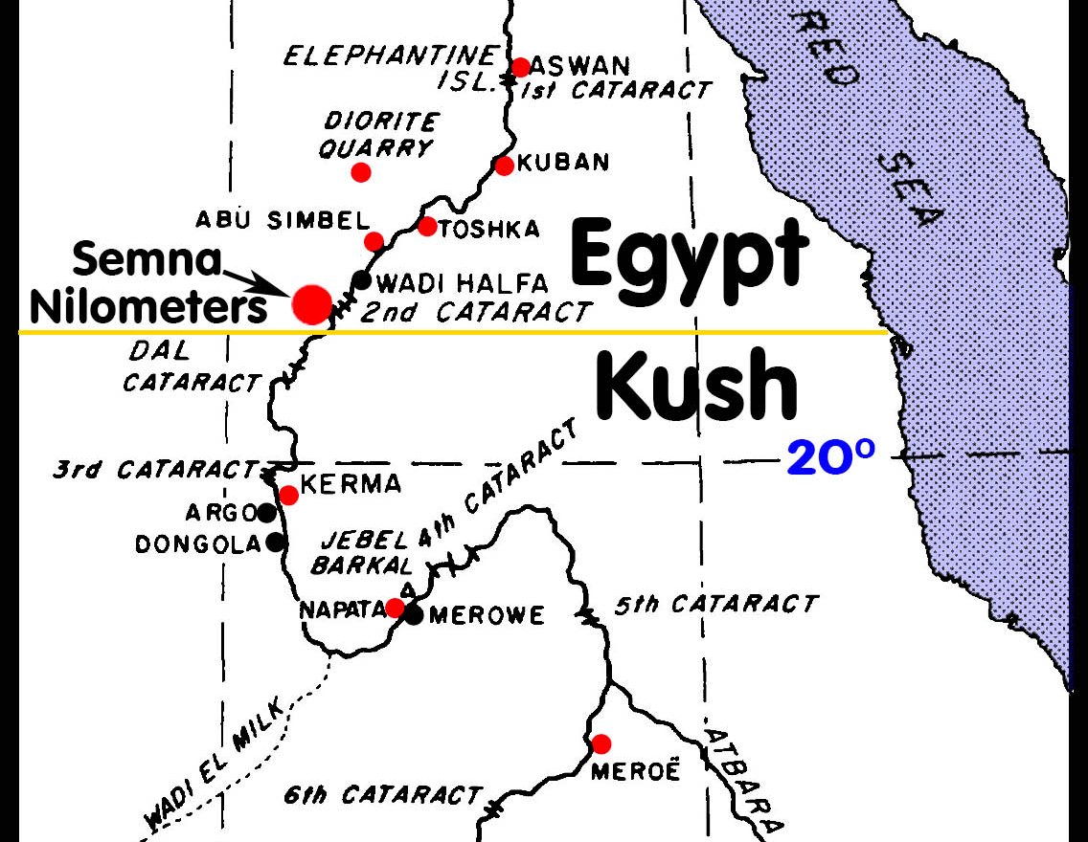
Variables in determining the observation location
9. Elephantine/Semna as the observation city
Island
of Sehel
at Aswan

Slide 28
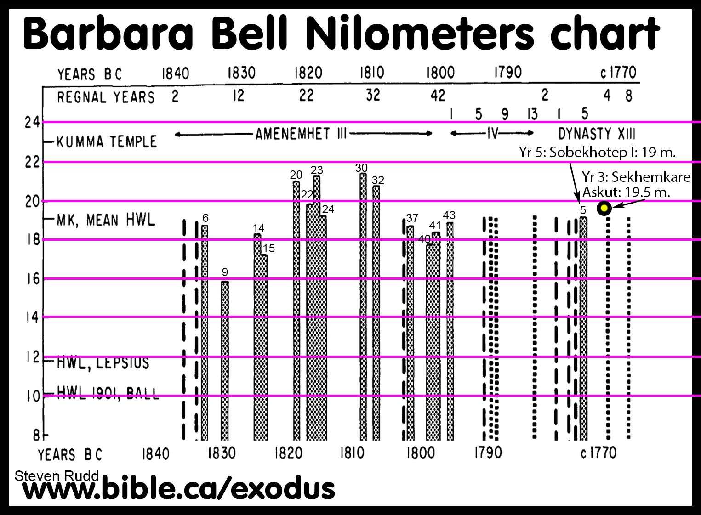
Climate and the History of Egypt: The Middle Kingdom, Barbara Bell, American Journal of Archaeology, vol 79, no. 3, p230, 1975 AD

Slide 29
Variables in determining the observation location
9. Elephantine/Semna as the observation city
Ancient literary sources
9D. Nilometer highwater Level (HWL) marks on rocks at cataracts:
Three years after recording the rising of Sirius in the 7th year, Sesostris III recorded a Nilometer Highwater Level (HWL) at the Dal Cataract in his 10th year. A total of 29 Nilometer High Water Levels (HWL) were recorded near the 2nd cataract over a period of 80 years, with the earliest recorded in the 10th year of Sesostris III into 13th Dynasty.
Barbara Bell noted:
“There is little evidence on the Nile levels in the reign of Senwosret III. But the recent discovery, at the Dal Cataract, of an inscription commemorating a water level on 24 Jan. 1869, year 10 of Senwosret III, close to the modern HWL, makes it reasonable to think the Nile may have been more erratic in the reign of this king than under his predecessors. When the river remains high, as in that year, long after its normal time, the fields will not be ready for planting in the normal (November) season and the crops may not have time to mature before the next flood.” (Climate and the History of Egypt: The Middle Kingdom, Barbara Bell, American Journal of Archaeology, vol 79, no. 3, p258, 1975 AD)
[10th year in 1869 BC was 3 years after the last of 7 years of famine in HC; 1827 BC in LC]

Slide 30
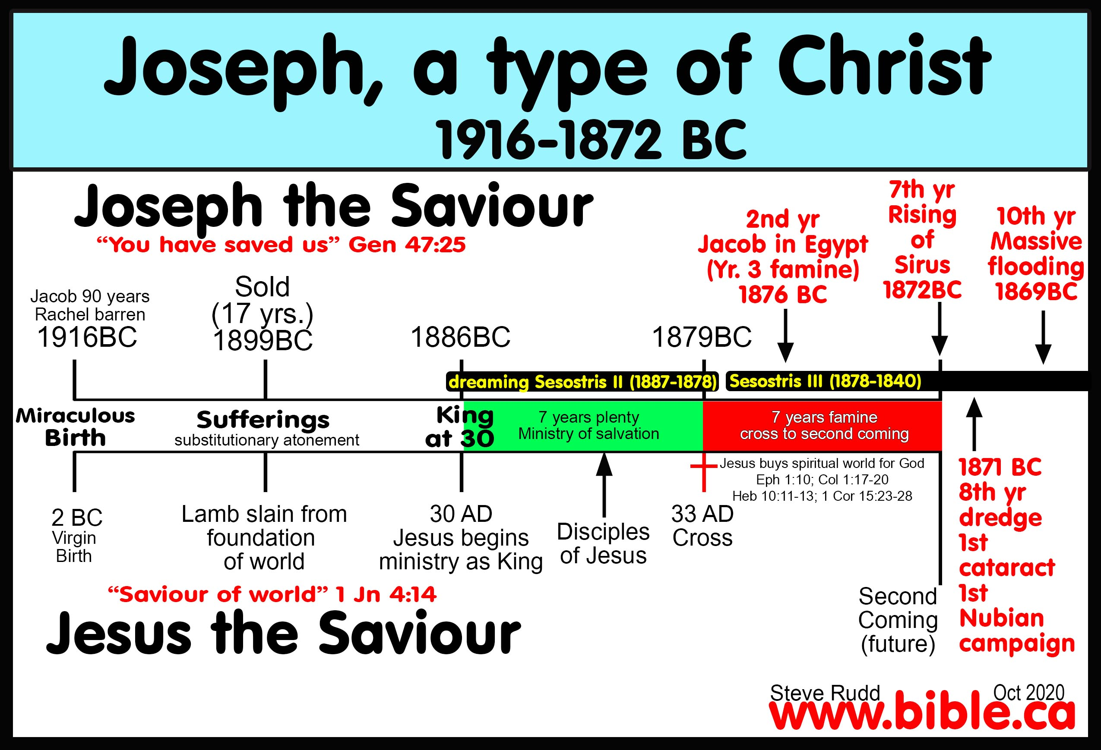

Slide 31
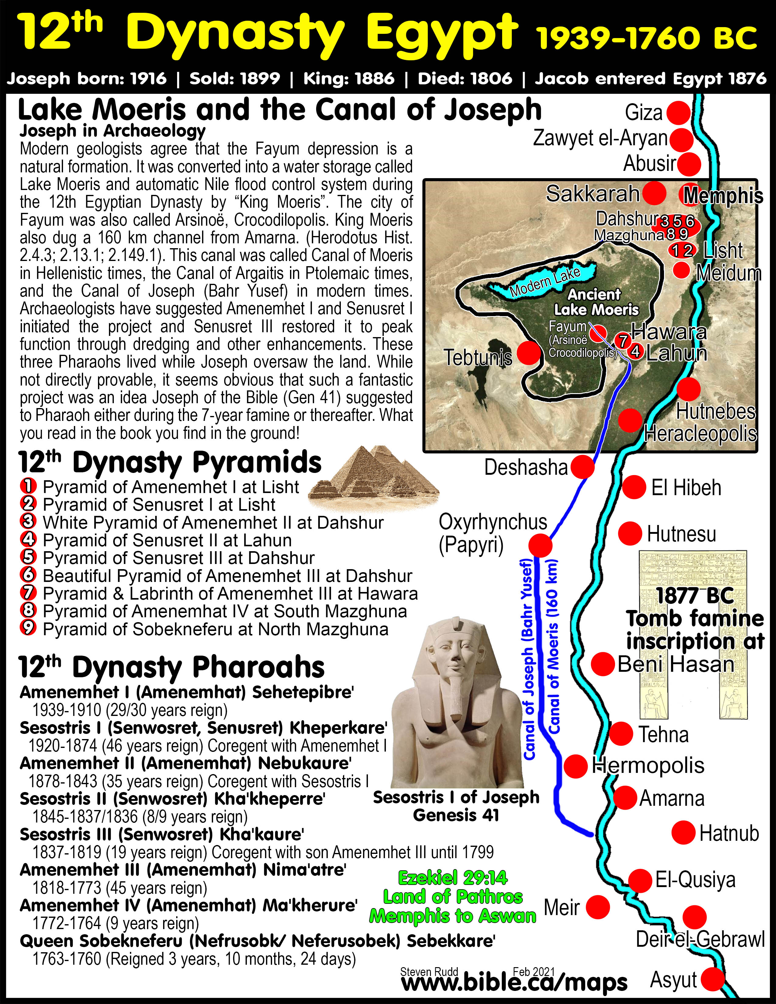
Canal and Lake of Joseph lessened damage from ultra high Nile floods recorded by Barbara Bell:
Joseph may have started the “Canal of Joseph” and the “Lake of Joseph” during the 7 years of famine, but he could not have finished it in time for the ultra high flood in 10th year of Sesostris III, which was only 3 years after the 7 years of famine ended. It is also unlikely that Sesostris III would need to attack Nubia the year after the Nubians came to Egypt for food.

Slide 32
Variables in determining the observation location
9. Elephantine/Semna as the observation city
Ancient literary sources
The “Special Projects coordinators” of the 12th and 13th Dynasty:
It is suggested that 12th and 13th Dynasty Pharaohs would assign and commission a “special projects coordinator” the yearly job of first observing the rising of Sirius and second, the recording of the Nile high water levels (Nilometers/HWL). These royal officials would record the rising of Sirius at Elephantine when the flooding began in July, then walk from the 1st cataract to the 2nd cataract and record the highwater Nile flood level at Semna on the rocks. The annual Nilometers demonstrate the interest the 12th Dynasty Pharaohs had in measuring the peak Nile flood levels near Elephantine every year. This evidence suggests it would be natural to also record the annual rising of the Dog Star at the border of Egypt at Elephantine.

Slide 33
Variables in determining the observation location
9. Elephantine/Semna as the observation city
Sesostris II: Dreaming Pharaoh of Joseph
Island
of Sehel
Sesostris III
1st year: death of Sesostris II
2nd year of 7 years of famine
Jacob arrives the following year
7th year:
Rising of Sirius observed the same
year the 7 years of famine end.
8th year:
Dredges Elephantine cataract and 1st campaign to Nubia
10th year: Crop planting delayed
Nilometer Highwater Level marker
at Dal Cataract
80 years and 29 HWLs

Slide 34
Variables in determining the observation location
9. Elephantine/Semna as the observation city
Ancient literary sources
9D. The 18th Dynasty Pharaohs dredged the 1st cataract canal:
2 rock inscriptions at the Island of Sehel:
Thutmoses I dredged the 1st cataract canal in his 3rd year:
  “Year 3 [1508 BC], first month of the third season, day 22, under the majesty of the King of Upper and Lower Egypt, Okheperkere (Thutmose I), commanded to dig this canal, after he found it [stopped up] with stones, (so that) no [ship sailed upon it]. … His majesty sailed this canal in victory and in power, at his return from overthrowing the wretched Kush.”
  (Ancient Records of Egypt: 1st – 17th Dynasties, James Henry Breasted, 2.75, p32, 1906 AD)
Thutmoses III dredged the 1st cataract canal in his 50th year:
  “Year 50 [1435 BC], first (month) of the third season (ninth month), day 22, under the majesty of the King of Upper and Lower Egypt, Menkheperre (Thutmose III), given life. His majesty commanded to dig this canal, after he had found it stopped up with stones, (so that) no ship sailed upon it. He sailed down-stream upon it, his heart glad, having slain his enemies.”
  (Ancient Records of Egypt: 1st – 17th Dynasties, James Henry Breasted, 2.649, p260, 1906 AD)

Slide 35
Variables in determining the observation location
9. Elephantine/Semna as the observation city
The goddess Sopdet was was believed to trigger the annual Nile flood by her appearance. Festivals were based on the beginning of the Nile flooding, not the time of peak flooding. For 80 years, the Egyptians were obsessed in marking the Peak Nile flood levels, but this was less important to the Egyptians than marking the first appearance of Sirius when the Nile first began to rise.
12th Dynasty originated in Nubia/Elephantine
Archaeological evidence of activity at Elephantine
29 Nilometer HWLs for 80 years on rocks 12th – 13th Dynasty
Dredging at 1st Cataract 12th – 18th Dynasty

Slide 36
Lahun and Ebers Papyrus and the rising of the Dog Star
Conclusion
Both Papyri are unprovenanced, purchased on the black market at Lahun and Thebes.
Capital cities differed in the 12th and 18th Dynasty
Even if the original in situ locations of the papyri were known it is no help in determining observation city for the rising of Sirius because observations could have been made hundreds of kilometers from the city where the papyri were stored.
Concluding that the rising of Sirius was observed in the same city where is was purchased is like claiming a Dead Sea Scroll purchased in NYC is evidence the Hebrews inhabited Manhattan 2000 years ago.
The city of observation of the rising of Sirius determines if high or low Egyptian chronology is correct, which in turn, then determines whether Thutmoses III or Amenhotep II his son, was the Pharaoh of the exodus.

Slide 37

In which city was the rising of Sirius observed?
Memphis?
Lahun?
Itjtawy?
Elephantine?
Thebes?

Slide 38
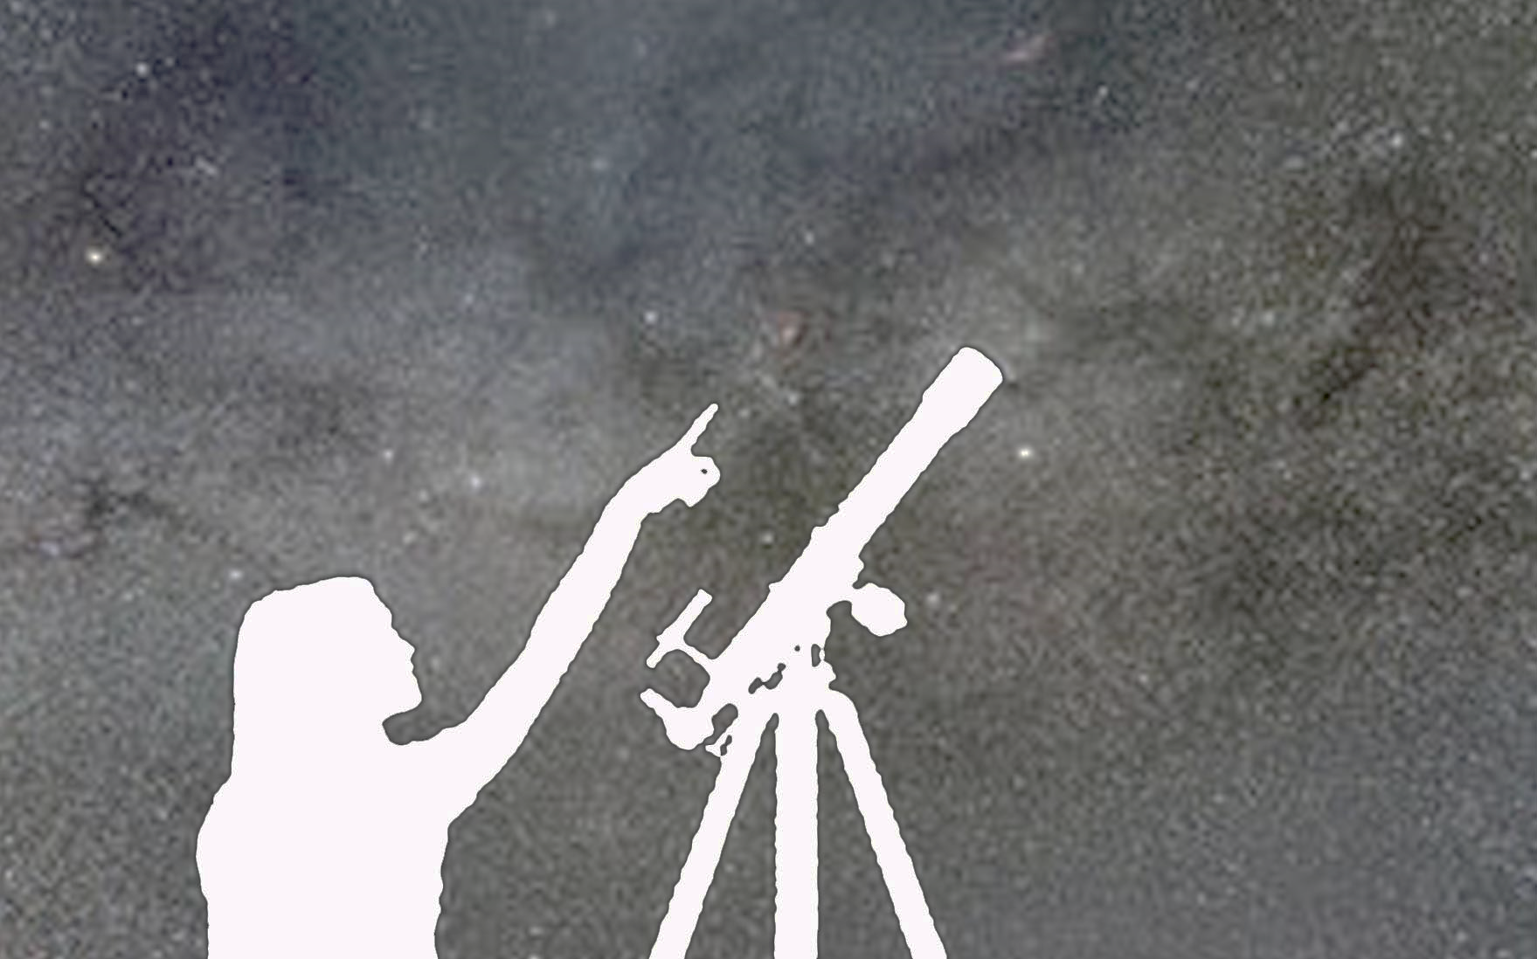
Dallas
We report
You decide
Thankyou for listening

Slide 39
PowerPoint:
www.Bible.ca/NEAS
Steven Rudd
ETS/NEAS
Dallas, Nov 2021

Slide 40
High vs. Low Egyptian Chronology, the Rising of Sirius in the Lahun and Ebers Papyri, and the exodus
Steven Rudd
Dallas 2021
ETS/NEAS
PowerPoint: www.bible.ca/NEAS
Canada@bible.ca www.bible.ca/exodus
4 buying options
Paperback colour: 590 pages: $195 USD
Paperback B&W, 590 pages: $80 USD
Digital 590 pages: $10 USD
Online: Free

